Slide 1





Slide 2


Learn how to be an EMPATHY DETECTIVE!
You need to
Notice – that something is wrong
Remember – if this has happened to you before
Imagine – if this happened to you
Ask - questions and listen
Care – show that you care about what happened
Here’s how…

Slide 3

NOTICE

Slide 4

Notice her face and her facial expression
This is Alex

Slide 5
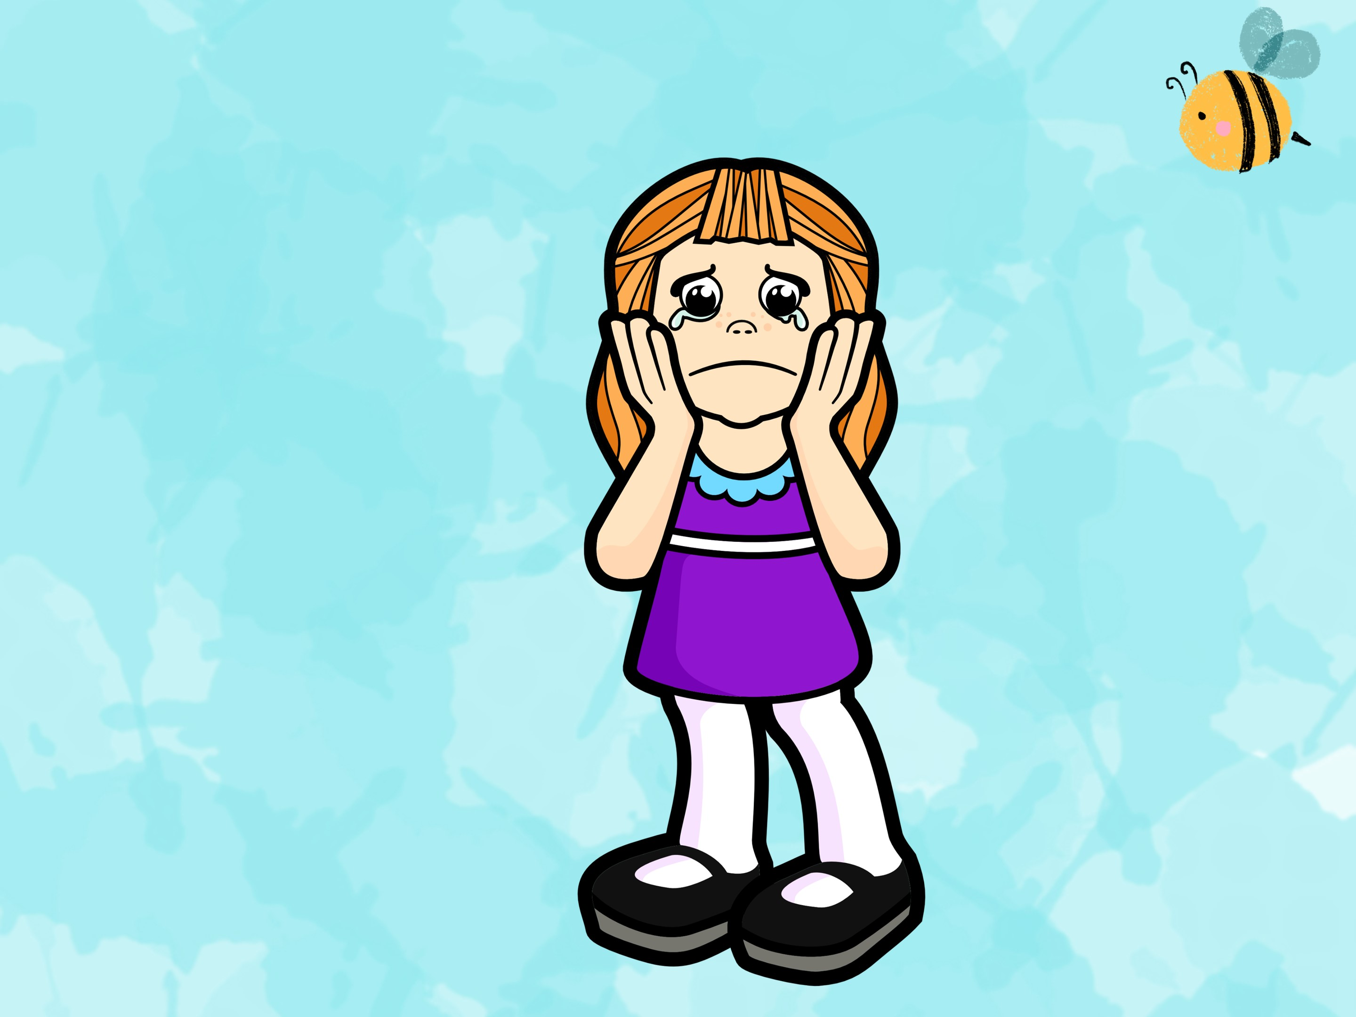
Notice her
body language.
Look at what she is doing…

Slide 6
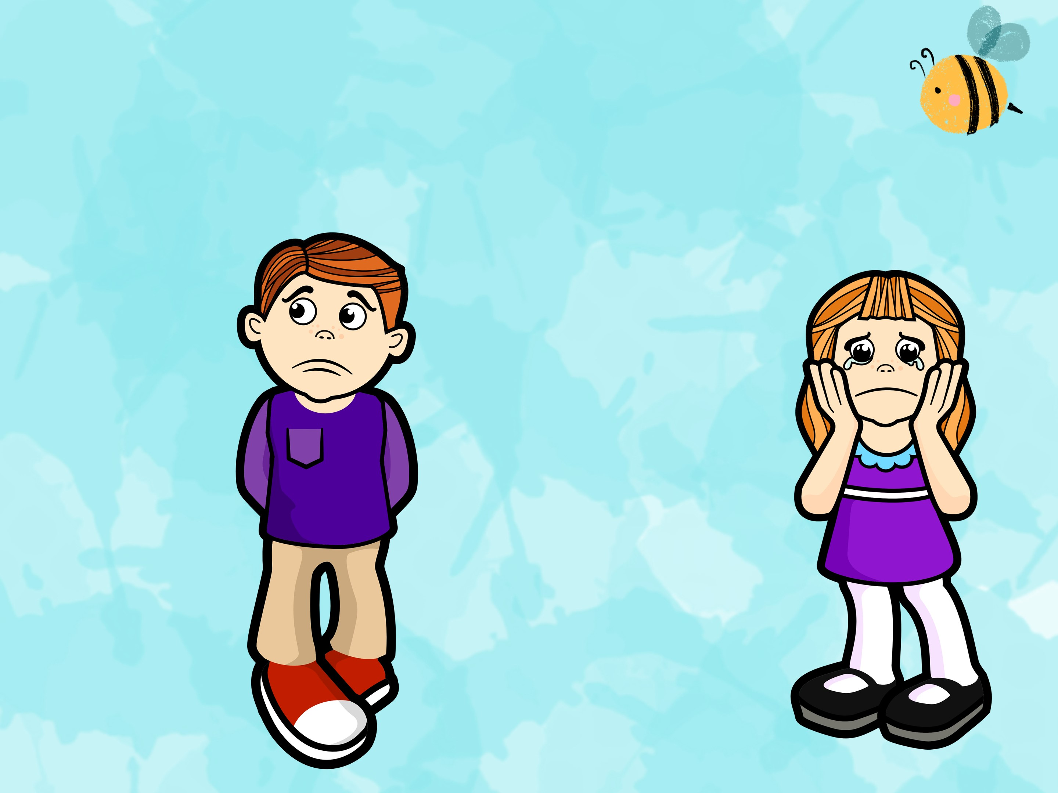
Notice what is
happening for Alex
I am so sorry but your cat has just died

Slide 7

Can you guess how
she is feeling?
She is ….

Slide 8
REMEMBER
Has this happened to you before?

Slide 9
Remember how it made YOU feel

Slide 10
IMAGINE
Can you imagine what it might be like?

Slide 11
If this happened to you can you imagine what it feels like. Can you put yourself in that person’s shoes?

Slide 12


?
ASK
Find out as much information as you can so you can help the person. Ask questions and listen carefully

Slide 13

?
Are you ok?
Do you need me to stay by your side?
What happened?
How are you feeling right now?
Shall I get an adult to help?
What do you need?
Can I help you?

Slide 14
CARE
Do something to show that you really do care about the person!

Slide 15

You could say ‘I am sorry you are feeling that way’.
You could ask if she needs a hug
You could show an appropriate facial expression
You could go and get help from an adult for her
You could use a calm and kind tone of voice
You could stay by her side and just be there if she need you
Do you have any other ideas?

Slide 16

REMEMBER!
Notice – that something is wrong
Remember – if this has happened to you before
Imagine – if this happened to you
Ask - questions and listen
Care – show that you care about what happened
Be an EMPATHY DETECTIVE!

